Slide 1
Virginia Natural Resources Funding and How It Compares to Other States
Fiscal Analytics, Ltd.
April 4, 2018

Slide 2
Introduction
Virginiaforever commissioned study of Virginia natural resource funding trends and how it compares to other states.
Study looked at specific funding levels for land conservation and water quality.
Particular emphasis was placed on comparisons with Chesapeake Bay neighboring states.

Slide 3
FY 2018 Virginia Natural Resource Funding
3

Slide 4
FY 2019 Virginia Natural Resource Funding
 | FY 2019 HB 30, Introduced Appropriations
Natural Resource Agency | General Fund | Special Funds | Federal Funds | Total
Secretary of Natural Resources | $609,254 | $0 | $102,699 | $711,953
Environmental Quality (DEQ) | $39,792,583 | $89,265,945 | $50,694,424 | $179,752,952
Conservation and Recreation (DCR)* | $74,388,003 | $42,228,826 | $12,932,770 | $129,549,599
Game and Inland Fisheries (DGIF) | $0 | $49,764,189 | $13,837,576 | $63,601,765
Marine Resources Commission | $13,152,535 | $9,108,613 | $3,430,800 | $25,691,948
Historic Resources | $4,650,230 | $1,182,635 | $2,095,715 | $7,928,580
Museum of Natural History | $2,833,105 | $343,410 | $95,596 | $3,272,111
Total NR Secretariat | $135,425,710 | $191,893,618 | $83,189,580 | $410,508,908
Dept. of Forestry Forest Mgmnt | $19,055,285 | $10,624,580 | $4,290,153 | $33,970,018
VDACS Farmland Preservation | $250,000 | $0 | $0 | $250,000
Total State Operating Appropriations | $20,871,213,958 | $25,974,249,289 | $9,617,160,351 | $56,462,623,598
Natural Resource Capital Approp. | $0 | $12,000,000 | $6,500,000 | $18,500,000
Total State Capital Appropriations | $10,000,000 | $724,475,000 | $11,000,000 | $745,475,000
NR as a % of Total State | 0.79% | 0.80% | 0.98% | 0.81%
* Includes $22.5 mil. deposit to the WQIF from FY 2017 revenue/balance surplus

Slide 5
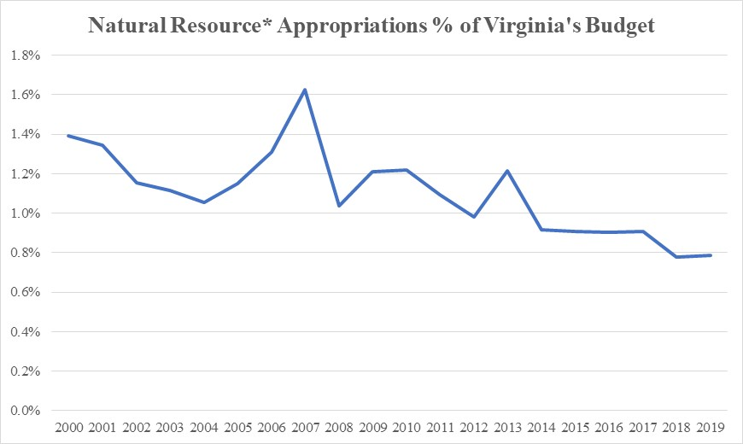
Includes Natural Resources Secretariat operating appropriations plus Dept. of Forestry Forest Mgmt., Farmland Preservation
Note: Natural resource appropriations do not include debt service payments on bonds contained within the Treasury Board budget.
5
5

Slide 6
General Fund Operating Appropriation Growth ($ Mil.)
 | 2001 | 2018 | Growth | Annualized Compound Growth
Medicaid (DMAS) | $1,384.2 | $4,651.7 | 236.1% | 7.4%
GF Debt Service | $243.1 | $739.5 | 204.2% | 6.8%
Behavioral Health | $430.2 | $772.6 | 79.6% | 3.5%
Other H&HS | $648.9 | $1,059.0 | 63.2% | 2.9%
K-12 Public Education | $3,942.4 | $5,972.7 | 51.5% | 2.5%
Public Safety/Comp Board | $1,949.1 | $2,588.3 | 32.8% | 1.7%
Higher Education | $1,634.2 | $2,015.2 | 23.3% | 1.2%
Natural Resources/Forest M | $152.1 | $128.2 | -15.7% | -1.0%
All Other | $1,899.4 | $2,372.1 | 24.9% | 1.3%
Total GF Operating | $12,283.6 | $20,299.3 | 65.3% | 3.0%
Note: Since 2001, the Consumer Price Index has averaged 2.0%.
6
6

Slide 7
NR Capital Needs Rely on Patchwork of Different Fund Sources Bonds Have Been Periodically Authorized for Water Quality
Fiscal Year | Land Conservation | Wastewater | Stormwater | Non-Point Source | Total Authorization
2014 | 73,796,521 | 140,432,800 | 35,000,000 | 9,100,000 | 258,329,321
General | 1,000,000 | 5,738,800 | 0 | 0
Federal | 0 | 28,694,000 | 0 | 0
Special | 2,000,000 | 0 | 0 | 9,100,000
Bonds* | 0 | 106,000,000 | 35,000,000 | 0
Credits | 70,796,521 | 0 | 0 | 0
2015 | 73,478,333 | 41,840,100 | 23,292,479 | 33,897,500 | 172,508,412
General | 2,000,000 | 13,292,100 | 0 | 23,897,500
Federal | 1,107,874 | 28,548,000 | 3,292,479 | 0
Special | 2,472,126 | 0 | 0 | 10,000,000
Bonds | 0 | 0 | 20,000,000 | 0
Credits | 67,898,333 | 0 | 0 | 0
2016 | 78,543,846 | 32,812,800 | 8,292,479 | 28,881,888 | 148,531,013
General | 5,927,000 | 5,468,800 | 5,000,000 | 10,696,471
Federal | 110,374 | 27,344,000 | 3,292,479 | 0
Special | 2,139,626 | 0 | 0 | 18,185,417
Bonds | 0 | 0 | 0 | 0
Credits | 70,366,846 | 0 | 0 | 0
2017 | 14,526,000 | 59,000,000 | 23,292,479 | 71,708,800 | 168,527,279
General | 8,500,000 | 0 | 0 | 61,708,800
Federal | 2,123,000 |  | 3,292,479 | 0
Special | 3,903,000 | 0 | 0 | 10,000,000
Bonds | 0 | 59,000,000 | 20,000,000 | 0
2018 | 12,404,000 | 0 | 3,292,479 | 18,274,474 | 33,970,953
General | 4,750,000 |  | 0 | 0
Federal | 2,013,000 |  | 3,292,479 | 0
Special | 5,641,000 |  | 0 | 18,274,474
Bonds | 0 |  | 0 | 0
* Does not include $75 mil in CSO bonds authorized for Richmond and Lynchburg

Slide 8
VA Direct Land Conservation Funding
Year | VLCF-GF | VLCF-NGF Approps | VLCF-Total | Capitol Authorizations | VFPF Direct Appropriations
2000 | 1,250,000 | 500,000 | 1,750,000 | 4,500,000
2001 | 9,600,000 | - | 9,600,000 | 1,000,000
2002 | - | - | - | 50,000,000
2003 | - | - | - | 500,000
2004 | - | 1,463,275 | 1,463,275 | -
2005 | 12,500,000 | 438,043 | 12,938,043 | 6,000,000
2006 | 2,500,000 | 972,523 | 3,472,523 | 100,000
2007 | 3,000,000 | 963,269 | 3,963,269 | 4,030,000
2008 | 3,000,000 | 397,880 | 3,397,880 | -
2009 | 2,000,000 |  | 2,000,000 | 31,000,000 | 500,000
2010 | 2,000,000 | 4,666 | 2,004,666 | - | 500,000
2011 | 500,000 | 2,000,000 | 2,500,000 | -
2012 | 1,500,000 | 2,000,000 | 3,500,000 | -
2013 | 1,000,000 | 2,000,000 | 3,000,000 | -
2014 | 1,000,000 | 2,000,000 | 3,000,000 | -
2015 | 1,000,000 | 2,000,000 | 3,000,000 | 1,580,000 | 1,000,000
2016 | 4,000,000 | 2,000,000 | 6,000,000 | 427,000 | 1,750,000
2017 | 8,000,000 | 2,000,000 | 10,000,000 | 4,026,000 | 500,000
2018 | 4,500,000 | 2,000,000 | 6,500,000 | 5,654,000 | 250,000
Note: Does not include Battlefield Preservation Fund. FY 2018-20 introduced budget maintained $4.5 m. VLCF GF appropriation.
House budget eliminated FY 2019 amount, Senate budget reduced each year by $3.0 m.
8

Slide 9
Virginia Wastewater/Stormwater Funding *
 | Wastewater |  |  |  | Stormwater
Year | DEQ/WQIF | Bonds | Clean Water Revolving Loan Fund -- State & Federal |  | SLAF
2000 | 13,870,000 | - | 35,672,280
2001 | 13,000,000 |  | 32,994,029
2002 | - |  | 32,797,038
2003 | - |  | 32,610,724
2004 | - |  | 32,546,804
2005 | 13,252,500 |  | 26,506,882
2006 | 84,188,600 |  | 21,547,742
2007 | 217,000,000 |  | 26,284,500
2008 | 20,000,000 |  | 16,711,477
2009 | 476,000 |  | 16,711,477
2010 | - | 250,000,000 | 50,037,600
2011 | 3,644,300 |  | 36,264,000
2012 | - |  | 34,708,000
2013 | 87,569,394 |  | 32,787,600 |  | 1,000,000
2014 |  | 106,000,000 | 34,432,800 |  | 35,000,000
2015 | 7,582,500 |  | 34,257,600 |  | 23,292,479
2016 | - |  | 32,812,800 |  | 28,292,479
2017 |  | 59,000,000 |  |  | 3,292,470
2018 |  |  |  |  | 3,292,470
* Does not include $75 mil in CSO bonds authorized in FY 2014 for Richmond and Lynchburg. $20 mil CSO proposal for FY 2019.

Slide 10
Virginia Non-Point Pollution Control Funding*
Year | DCR/WQIF (GF) | Recordation Fees/Other NGF | DCR/WQIF Reserve Fund
2000 | 9,831,250
2001 | 12,040,462 | 1,000,000
2002 | 1,040,462
2003 | 3,652,981 | 2,179,000
2004 | 685,473 | 2,200,637
2005 | 9,876,357 | - | 226,616
2006 | 61,346,933 | - | 9,111,940
2007 | 4,285,868 | - | 199,605
2008 | 685,473 | - | 500,000
2009 | 1,112,300 | - | 20,000,000
2010 | 15,200,000 | - | 4,800,000
2011 | 27,878,895 | 9,100,000 | 4,919,805
2012 | - | 9,100,000 | -
2013 | 19,679,048 | 9,100,000 | 1,300,000
2014 |  | 9,100,000
2015 | 20,931,888 | 10,000,000 | 2,965,612
2016 | 10,696,471 | 10,000,000 | 8,185,417
2017 | 53,464,590 | 10,000,000 | 8,244,210
2018 | - | 10,000,000 | 8,274,474
* Does not include AG BMP tax credit program (approx. $1 mil per year)

Slide 11
Tax Credits for Land Conservation Are Also Available
Virginia Land Preservation Tax Credit
Year | # of Credits | # of Acres | Tax Credits Allocated | Tax Credits Claimed
2000-06 | 1,557 | 295,070 | $736,837,981 | $426,832,755
2007-08 | 478 | 119,504 | $202,287,081 | $236,858,621
2009 | 228 | 63,409 | $106,647,006 | $85,153,370
2010 | 146 | 38,551 | $106,845,000 | $131,579,152
2011 | 367 | 75,025 | $108,424,000 | $118,426,367
2012 | 228 | 45,329 | $64,090,780 | $95,100,354
2013 | 234 | 64,909 | $78,882,596 | $69,991,847
2014 | 136 | 31,428 | $55,648,387 | $70,796,521
2015 | 182 | 42,362 | $48,625,672 | $67,898,333
2016* | 163 | 30,983 | $58,475,935 | $70,366,846
2017* | 31 | 7,216 | $7,865,915
Total | 3,750 | 813,786 | 1,574,630,353 | $1,373,004,166
* Partial year data. Tax credits are allocated and claimed on a calendar year basis rather than a fiscal year.
Source: Larry Durbin, Assistant Tax Commissioner, Va Dept. of Taxation, May 24, 2017
11

Slide 12
How Does Virginia NR Funding Compare to Virginiaforever Goals?
Virginiaforever’s Five-Year Plan 2015-2019:
$833,785,000 state investment to meet land conservation goals.
$805,000,000 state investment to meet water quality, wastewater, stormwater, and agriculture BMP improvement goals.
Current State FY 2015-2019 Funding Policies:
$410 million appropriated/tax credits for land conservation (mainly Land Preservation Tax Credits). House budget cuts VLCF GF budget by $4.5 mil. in FY 2019, Senate budget cuts VLCF $3 mil. each year.
Assumes $75 million in each fiscal year 2017-19 for the land preservation tax credit.
Virginiaforever’s Five-Year Plan for land conservation underfunded by at least $423 million.
$545 million appropriated for water quality and agriculture BMP.
Assumes $106 million in wastewater bonds, $75 million in combined sewer overflow bonds for Richmond and Lynchburg cities, and the $35 million for the Stormwater Local Assistance Fund (SLAF) authorized in the 2014 Session, plus $20 mil. for CSO bonds (FY 19) are included as issued in 2015-19.
Assumes current trends in the state match for the Clean Water Revolving Fund and $10 million in recordation fees allocated for agriculture BMP’s in FY 2019. Also includes the recently announced $22.5 million in Part A and B FY 2019 deposits to the Water Quality Improvement Fund (WQIF) as a result of the FY 2017 revenue and balance surplus and $1 mil. per year in Ag BMP tax credits.
Virginiaforever’s Five-Year Plan for water quality underfunded by $260 million.

Slide 13
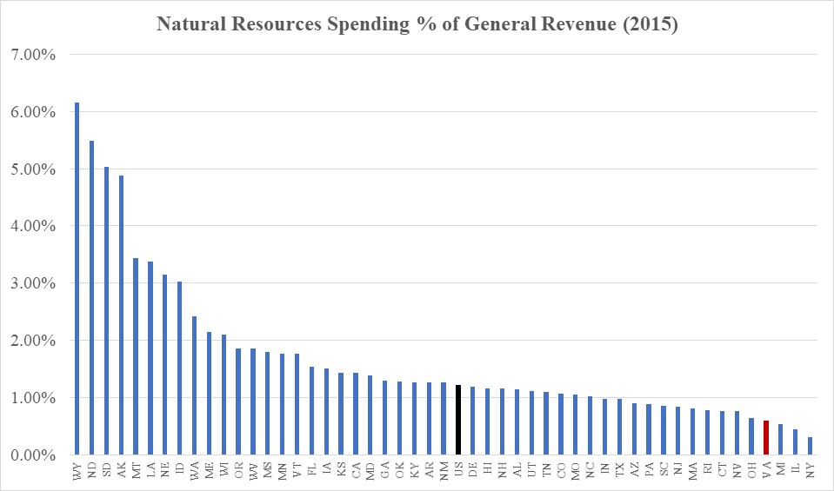
U.S. Census Bureau Data Ranks Virginia Near the Bottom in Natural Resource Spending

Slide 14
U.S. Census Bureau Data Ranks Virginia Much Lower than our Surrounding States

Slide 15
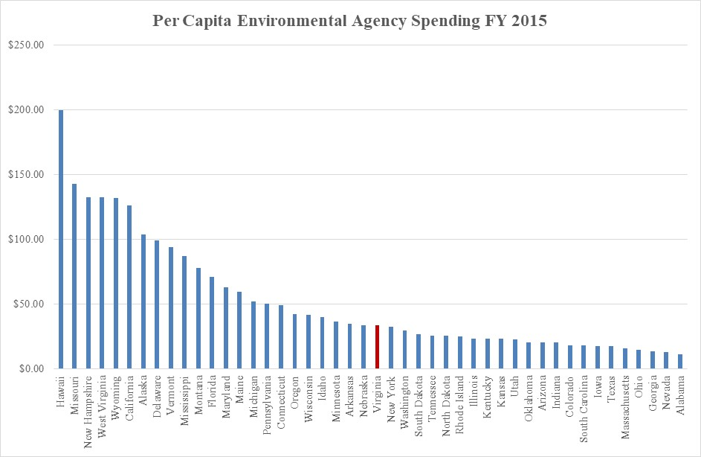
According to ECOS*, Virginia Ranks in the Middle for Environmental Regulatory Agency Spending
* Environmental Council of the States

Slide 16
VA Environmental Regulatory Spending is Less than Other Chesapeake Bay States

Slide 17
Maryland is the Leader in Spending for Chesapeake Bay Restoration
State Spending for Chesapeake Bay Watershed Restoration ($ Thous.)
 | FY 2015 | FY 2016 | FY 2017 | FY 2018
Delaware | $750 | $750 | $750 | $750
District of Columbia | $39,628 | $49,631 | $63,271 | $45,025
Maryland | $498,519 | $739,882 | $488,377 | $748,382
New York | $6,723 | $9,522 | $7,312 | $8,690
Pennsylvania | $86,529 | $51,080 | $88,620 | $37,015
Virginia | $226,175 | $227,717 | $228,131 | $204,725
West Virginia | $43,326 | $86,083 | $35,733 | $9,367
TOTAL | $901,650 | $1,164,665 | $912,194 | $1,053,954
Source: http://chesapeakeprogress.com/files/CBARA_Reporting_FY18_Chesapeake_Bay_Crosscut_FINAL.pdf

Slide 18
Virginia Chesapeake Bay Restoration Spending*
 | FY 2015 | FY 2016 | FY 2017 | FY 2018
Department of Conservation and Recreation
Soil and Water Conservation | $7,595 | $8,184 | $9,406 | $7,655
Ag Best Management Practices Assistance | $14,879 | $14,503 | $24,180 | $5,280
State Park Management and Operations | $22,962 | $24,770 | $25,776 | $24,404
Preservation of Open Space and Natural Heritage | $4,735 | $5,840 | $7,185 | $7,714
General Administration and Other | $8,129 | $7,550 | $9,813 | $8,000
Subtotal DCR | $58,300 | $60,847 | $76,360 | $53,053
Department of Environmental Quality
Water Quality Improvement Point Source | $65,143 | $53,149 | $42,849 | $21,316
Water Quality Improvement Non-Point Source | $306 | $259 | $181 | $900
Clean Water SRF | $34,972 | $45,734 | $34,344 | $34,000
Stormwater Local Assistance and Management | $11,375 | $6,132 | $16,450 | $21,497
Water Quality Management | $14,335 | $14,374 | $15,041 | $16,211
Richmond and Lynchburg Cities CSO | $3,585 | $7,980 | $3,261 | $17,000
Land Management | $4,936 | $4,491 | $4,876 | $4,568
Petroleum Remediation | $21,636 | $23,138 | $23,808 | $24,253
Air Quality | $8,594 | $8,583 | $7,961 | $8,837
Superfund, Litter Control and Recycling | $2,993 | $3,030 | $3,000 | $3,090
Subtotal DEQ | $167,875 | $166,870 | $151,771 | $151,672
Total Virginia State Programs | $226,175 | $227,717 | $228,131 | $204,725
* FY 2018 report provided to Congress in response to Section 3 of the Chesapeake Bay Accountability and Recovery Act (CBARA).

Slide 20
Maryland NR Financing
Maryland has been a leader in enactment of strategies to reach its goals of cleaning up the Chesapeake Bay. Funding for Chesapeake Bay restoration has averaged $600 million per year from FY 2014 through FY 2018.
Program Open Space (1970), Agricultural Land Preservation Fund (1977), Rural Legacy Program (1997), and Heritage Conservation Fund
Funded with 0.5% real estate transfer tax that generates about $200 mil. per year.
(Revenues have often been diverted to the state GF.)
Water Quality Revolving Loan Fund
Allows local governments to access lower cost capital in lieu of issuing local debt.
The Bay Restoration Fund (2004)
Each residential dwelling that receives an individual sewer bill and each onsite sewage disposal system or holding tank that receives a water bill is subject to a $5.00 monthly fee ($100 mil. per year).
Each user of an onsite sewage disposal system that does not receive a water bill and each user of sewage holding tank that does not receive a water bill is subject to a $60 annual fee ($27 mil. per year).
Chesapeake and Atlantic Coastal Bays Trust Fund (2007)
Funds non-point source nutrient and sediment reduction projects and is capitalized with about $50 million in revenue from Maryland motor fuel and car rental taxes.

Slide 21
Pennsylvania NR Financing
Despite the following dedicated revenues for natural resources, Pennsylvania faces serious
challenges in meeting its commitments to reduce TMDL’s into the Chesapeake Bay.
The Keystone Recreation, Park and Conservation Fund (1993)
- Dedicates 0.15% real estate transfer tax to recreation, parks, and land conservation. Requires a minimum 50% match from recipient municipality or nonprofit organizations.
Agricultural Conservation Easement Fund
About 17 cents of the state cigarette tax of $2.60 per pack ($20.5 mil./year) to help preserve farmland.
Recycling and Environmental Stewardship Fund
$2.00 per ton fee (1989) and $0.25 per ton (1999) to grants to municipalities for recycling programs, waste facility studies, and state programs concerning litter control, recycling and waste reduction.
$35 mil. from the Oil and Gas Lease Fund
“Growing Greener” Initiative (1999 and 2005)
- Dedicated bond funding
- $4.00 per ton tipping fee (2002) at municipal landfills to finance land conservation and other environmental programs ($60 mil/year).

Slide 22
North Carolina NR Financing
In 2010, NC eliminated its dedicated source of NR funding and combined the Natural Heritage Trust Fund with the Clean Water Management Trust Fund.
- Formerly had dedicated funding for land conservation through a 10 cent per $100 real estate transfer tax.
Since the repeal of its dedicated funding source and tax credits, NC has relied upon General Fund appropriations, both recurring and one-time to support the three remaining conservation trust funds. 1) the Parks and Recreation Trust Fund, 2) the Clean Water Management Trust Fund, and 3) the Agriculture Development and Farmland Preservation Trust Fund.
In 2015, the NC General Assembly also repealed their conservation tax credit.
The credit was for 25 percent of the fair market value of property donated for conservation purposes not to exceed $500K for corporations and $250k for individuals. Unlike Virginia, the credits could not be sold.

Slide 23
Examples of State Dedicated Revenue Sources for Natural Resources
Real estate transfer taxes, deed recording fees
Dedicated sales taxes
Dedicated lottery revenues
Dedicated cigarette taxes*
Waste disposal tipping fee
Royalties on sale and lease of mineral rights
Dedicated motor fuel and car rental taxes
Water utility and “flush” fees
* Avg. state cigarette tax is $1.72 /pack. Va ranks 50th at 30 cents. Georgia is 49th at 37 cents.
7 cent increase in VA tax would generate about $33 mil. per year.

Slide 24
Virginia Has the Most Generous Land Preservation Tax Credit

Slide 25
FY 2018 GF Revenue Growth Encouraging Versus Forecast, Likely Year-End Surplus Resulting in a WQIF Allocation
 | % of GF | Est. Growth | Thru Feb. GF Growth
Withholding | 63.1% | 3.5% | 5.6%
Est Payments/Tax Dues | 16.8% | 4.3% | 19.0%
Refunds | -10.1% | 5.8% | 7.9%
Net Individual Income | 69.8% | 3.4% | 7.5%
Sales Taxes* | 18.0% | 3.0% | 3.2%
Corporate Income | 4.4% | 5.7% | 13.3%
Recordation | 2.1% | 3.3% | -2.3%
Insurance Premiums | 1.9% | 6.2% | -25.6%
Total GF Revenues | 100.0% | 3.4% | 6.2%
* 19.2% share of GF when including 0.375 cent sales tax transfer to the GF
25

Slide 26
All Other (Net Debt Service)
K-12 Direct Aid @ 3% growth
Medicaid @ 6% growth
26
26

Slide 27
…But Virginia Has Relatively Little Room for More Borrowing*
Introduced Budget Proposed Authorizing $730 Mil. in New Debt in FY 20
* Additional debt capacity based on self-imposed cap of 5% of GF + transportation revenues.
DCAC model assumes an average of $580 mil. per year over next 10 years can be issued.
Source: Virginia Debt Capacity Advisory Board, Dec. 2017
27
27
27

Slide 28
National Rankings Indicate a Relatively Low State Tax Burden Given our State’s Wealth
 | 2012 JLARC Ranking | 2018 JLARC Ranking
Per capita personal income | 8 | 12
Per capita state taxes | 34 | 33
Per capita local taxes | 13 | 16
Source: Virginia Compared to Other States, JLARC, 2012, 2018 Editions
28
28
28
28
28

Slide 29
Summary
Low growth in state GF revenues and high growth in Medicaid and debt service has meant a continued degradation in ongoing GF state support for natural resource programs. Will Medicaid expenditure growth slow by moving to managed care, and will revenues sustain faster growth to allow more state investment in natural resources?
Since the 2009 recession, state funding has not been restored to many priority programs, including education.
There is very limited new state debt capacity available and still remain a AAA-rated state. Governor and General Assembly have created another reserve fund to maintain AAA rating – causing additional scarcity for restoring funding.
Local revenues are under even more stress than state revenue sources.
A sustainable new revenue source is needed if Virginia is to meet goals for land conservation and water quality.
29
29
29

Slide 30
Appendix

Slide 31
Governor’s Introduced Budget
 | GF Budget Accounting ($ Mil.)
 |  |  | Change from FY18 |  |  | Change from FY19
 | 2018 Caboose | FY 2019 | $ | % | FY 2020 | $ | %
Legislative and Executive | $119.4 | $123.7 | $4.3 | 3.6% | $123.7 | $0.0 | 0.0%
Judicial Dept. | 485.6 | 496.0 | $10.4 | 2.1% | 496.0 | $0.0 | 0.0%
Administration/Comp Board | 714.3 | 736.7 | $22.4 | 3.1% | 739.6 | $2.9 | 0.4%
Treasury Board Debt Service | 739.5 | 759.1 | $19.6 | 2.7% | 807.6 | $48.5 | 6.4%
Other Finance/Technology | 31.1 | 191.2 | $160.1 | 514.8% | 189.8 | -$1.4 | -0.7%
Rainy Day Fund Deposit | - | - | - | - | - | - | -
Car Tax Reimbursement | 950.0 | 950.0 | $0.0 | 0.0% | 950.0 | $0.0 | 0.0%
Commerce and Trade | 203.5 | 208.9 | $5.4 | 2.7% | 210.3 | $1.4 | 0.7%
Nat. Resources/Agriculture | 163.7 | 191.9 | $28.2 | 17.2% | 168.9 | -$23.0 | -12.0%
K-12 Education/Central Office | 6,031.2 | 6,297.5 | $266.3 | 4.4% | 6,400.8 | $103.3 | 1.6%
Higher & Other Education | 2,015.2 | 2,119.8 | $104.6 | 5.2% | 2,148.6 | $28.8 | 1.4%
DMAS Medicaid | 4,651.7 | 4,651.2 | -$0.5 | 0.0% | 4,796.3 | $145.1 | 3.1%
Other Health & Human Services | 1,847.1 | 1,949.5 | $102.4 | 5.5% | 2,029.1 | $79.6 | 4.1%
Public Safety & Veterans/HS | 1,938.0 | 2,030.8 | $92.8 | 4.8% | 2,041.8 | $11.0 | 0.5%
Transportation | 41.0 | 43.0 | $2.0 | 4.9% | 43.0 | $0.0 | 0.0%
Central Appropriations | 211.3 | 71.5 | -$139.8 | -66.2% | 188.6 | $117.1 | 163.8%
Cash Reserve | 156.4 | 50.0 | -$106.4 | -68.0% | 220.7 | $170.7 | 341.4%
Independent Agencies/Capital | 0.3 | 10.4 | $10.1 | NM | 5.3 | -$5.1 | -49.0%
Total GF Appropriations | $20,299.3 | $20,881.2 | $581.9 | 2.9% | $21,560.1 | $678.9 | 3.3%
GF Revenues | 19,328.2 | 20,096.5 | $768.3 | 4.0% | 20,892.3 | $795.8 | 4.0%
Transfers | 622.7 | 615.7 | -$7.0 | -1.1% | 625.8 | $10.1 | 1.6%
Rainy Day Fund Withdrawal | 272.5 | - |  |  | -
Balances for Appropriation | 201.6 | 22.0 |  |  | (0.5)
Unappropriated Balance |  | 54.6 |  |  | 12.1
31
31
31

